Slide 1
Bank classification

Slide 2
Introduction
The data is related with direct marketing campaigns of a Portuguese banking institution. The marketing campaigns were based on phone calls.
Often, more than one contact to the same client was required, in order to access if the product (bank term deposit) would be ('yes') or not ('no') subscribed.
The csv comes with all examples (41188) and 20 inputs, ordered by date (from May 2008 to November 2010)
The classification goal is to predict if the client will subscribe (yes/no) a term deposit (variable y).

Slide 3
Features
Input variables:
Bank client data
1 - age (numeric) 2 - job : type of job (categorical: 'admin.','blue-collar','entrepreneur','housemaid','management','retired','self-employed','services','student','technician','unemployed','unknown') 3 - marital : marital status (categorical: 'divorced','married','single','unknown'; note: 'divorced' means divorced or widowed) 4 - education (categorical: 'basic.4y','basic.6y','basic.9y','high.school','illiterate','professional.course','university.degree','unknown') 5 - default: has credit in default? (categorical: 'no','yes','unknown') 6 - housing: has housing loan? (categorical: 'no','yes','unknown') 7 - loan: has personal loan? (categorical: 'no','yes','unknown')
Related with the last contact of the current campaign:
8 - contact: contact communication type (categorical: 'cellular','telephone') 9 - month: last contact month of year (categorical: 'jan', 'feb', 'mar', ..., 'nov', 'dec') 10 - day_of_week: last contact day of the week (categorical: 'mon','tue','wed','thu','fri') 11 - duration: last contact duration, in seconds (numeric).
Other attributes
12 - campaign: number of contacts performed during this campaign and for this client (numeric, includes last contact) 13 - pdays: number of days that passed by after the client was last contacted from a previous campaign (numeric; 999 means client was not previously contacted) 14 - previous: number of contacts performed before this campaign and for this client (numeric) 15 - poutcome: outcome of the previous marketing campaign (categorical: 'failure','nonexistent','success')
Social and economic context attributes
16 - emp.var.rate: employment variation rate - quarterly indicator (numeric) 17 - cons.price.idx: consumer price index - monthly indicator (numeric) 18 - cons.conf.idx: consumer confidence index - monthly indicator (numeric) 19 - euribor3m: euribor 3 month rate - daily indicator (numeric) 20 - nr.employed: number of employees - quarterly indicator (numeric)
Output variable: 21 - y - has the client subscribed a term deposit? (binary: 'yes','no')

Slide 4
Methods
Train model
Make prediction
Basic statistical data
Split data train & test
Basic info, data type, missing data
Import libraries
Numpy
Matplotlib
Sklearn (train_test_split,label encoder, robustscaler, SMOTE, accuracy score, confusion matrix, logistic regression, decision tree classifier)
Data Inspections
Load and explore data
Categorical & numerical variables distribution
Data preprocessing
Encoding
Correlation matrix
Scaling
Deal with imbalanced data (SMOTE)
Logistic regression
Decision tree
Test data
Evaluate model
Interpret result & comparison
Visualize results
Accuracy score
Confusion matrix

Slide 5
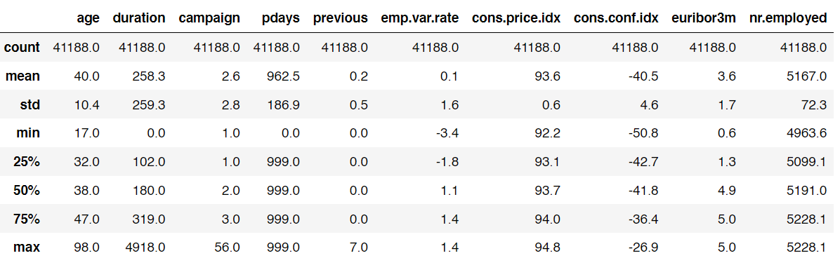
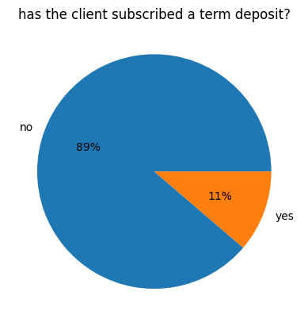
Basic Statistical Data

Slide 6
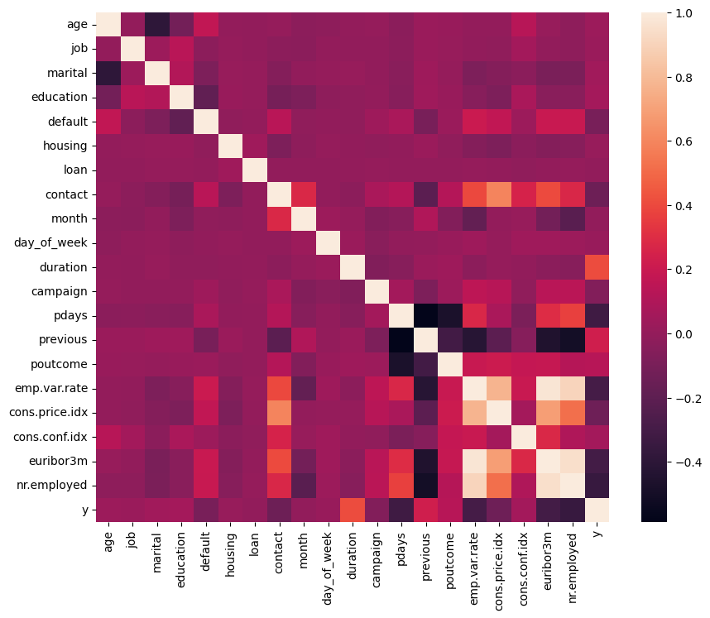
Correlation

Slide 7
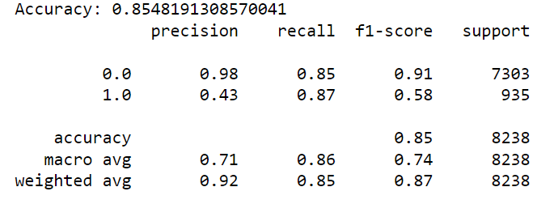
Logistic Regression Classification
Interpretation:
The accuracy is approx. 91%, indicating the model correctly predicted the outcome y about 91% of the outcome in the test set
Test set size is 8238 instances which divided into 935 instances of class 1 (yes) and 7303 instances of class 0 (no)
the model performs better at predicting class 0, which is indicated by high precision, recall, and f1-score (>90%)
however, it doesn't perform well at predicting class 1, especially in terms of recall / sensitivity. the model only correctly predicted 41% of the actual positive instances
the model struggles to predict clients who choose to subscribe a term deposit

Slide 8
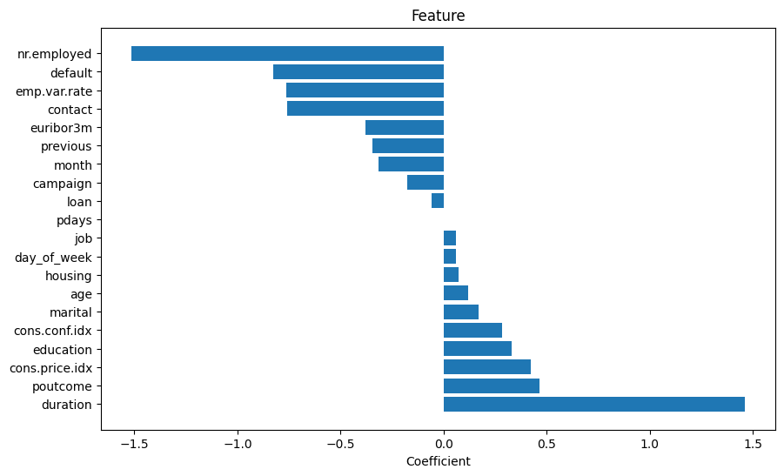
Plotting the feature importance
Duration: The feature 'duration' has the highest positive coefficient, suggesting a strong positive influence on the target. A longer 'duration' may correlate with a higher likelihood of client interested to subscribe to term deposit
Cons.Price.Index (Consumer Price Index) and Cons.Conf.Index (Consumer Confidence Index) show a moderate positive influence indicating their positive influence on the target. This may related to both high consumer price index and consumer confidence index are the indicators for consumer spending behavior and changes in cost of living,
Poutcome (Outcome of Previous Campaign) has a higher positive coefficient, suggesting a moderate positive relationship with the target. Previous subscriber are more likely to subscribe again it the next period.
Features like 'housing', 'education', 'day_of_week', 'marital', and 'age' exhibit mild positive associations with the target but with smaller coefficients.
'Job', 'loan', 'pdays', 'campaign', 'previous', and 'euribor3m' have coefficients close to zero, indicating relatively weaker or negligible influence on the target.
Features like 'contact', 'nr.employed', 'emp.var.rate', and 'default' show notable negative influences on the target.

Slide 9
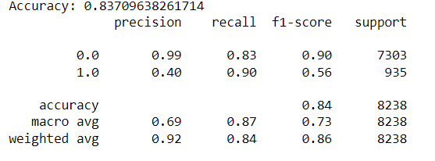
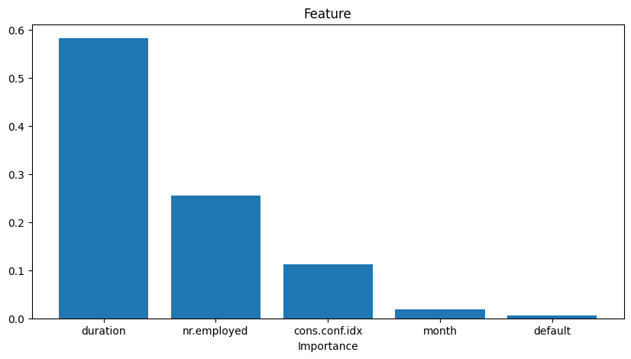
Decision Tree Classification

Slide 10
Conclusion
Both models have similar overall accuracy, precision, and weighted average F1-scores.
Both models perform well in predicting the majority class (Class 0, no) with high accuracy and balanced precision-recall scores.
For the target output class (Class 1, yes), both model has a slightly higher recall, indicating they can better identify positive instances, but at the cost of a slightly lower precision (0.43 for both models).
Both model seem to give similar result in duration and nr.employed (number of employees) as important features. Although there are some differences, such as euribor3m and age feature, which middle to lower importance in logistic regression but high in decision tree.

